Slide 1
Traffictelligance Advanced Traffice Volume Estimation
SlideMake.com

Slide 2

Introduction to Traffictelligance Advanced Traffic Volume Estimation
Traffictelligance utilizes sophisticated methods to accurately estimate traffic volumes on various networks.
Advanced estimation techniques help in understanding traffic patterns and optimizing network performance.
This presentation explores the core concepts, methodologies, and benefits of advanced traffic volume estimation.
Notes:
Image source: https://i.ytimg.com

Slide 3
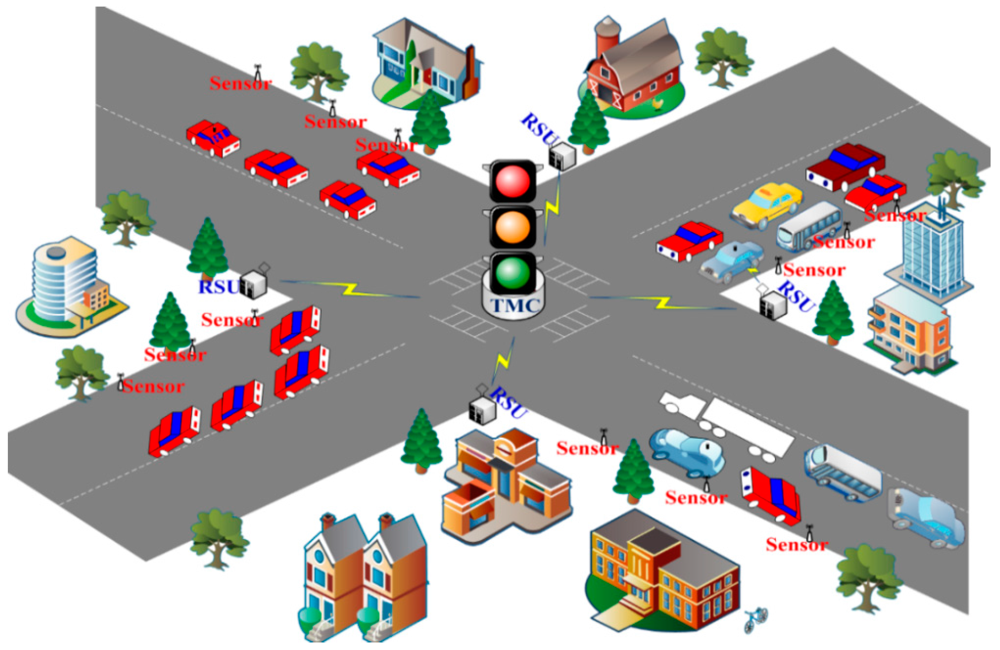
Importance of Accurate Traffic Volume Estimation
Precise traffic data is critical for network planning, capacity management, and congestion mitigation.
Accurate estimates enable service providers to improve quality of service and customer satisfaction.
Without reliable traffic insights, network resources may be underutilized or overstressed, leading to inefficiencies.
Notes:
Image source: https://pub.mdpi-res.com

Slide 4
Core Challenges in Traffic Volume Estimation
Variability in user behavior and traffic sources can complicate accurate volume estimation.
Limited or incomplete data collection can hinder the precision of traffic models.
Dynamic network environments require adaptive estimation techniques to remain effective.
Notes:
Image source: https://www.researchgate.net

Slide 5
Traditional Traffic Estimation Methods
Historical averaging provides basic estimates but lacks responsiveness to real-time changes.
Probe-based methods rely on measurements from selected network points, which may not cover all traffic.
These methods often fall short in capturing complex traffic dynamics in modern networks.
Notes:
Image source: https://i.ytimg.com

Slide 6
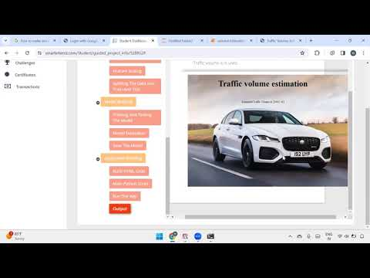
Advanced Traffic Estimation Techniques Overview
Machine learning models can analyze large datasets to predict traffic with high accuracy.
Statistical modeling incorporates probabilistic approaches to handle uncertainties and variability.
Hybrid models combine multiple techniques for more robust and comprehensive traffic volume estimation.
Notes:
Image source: https://i.ytimg.com

Slide 7
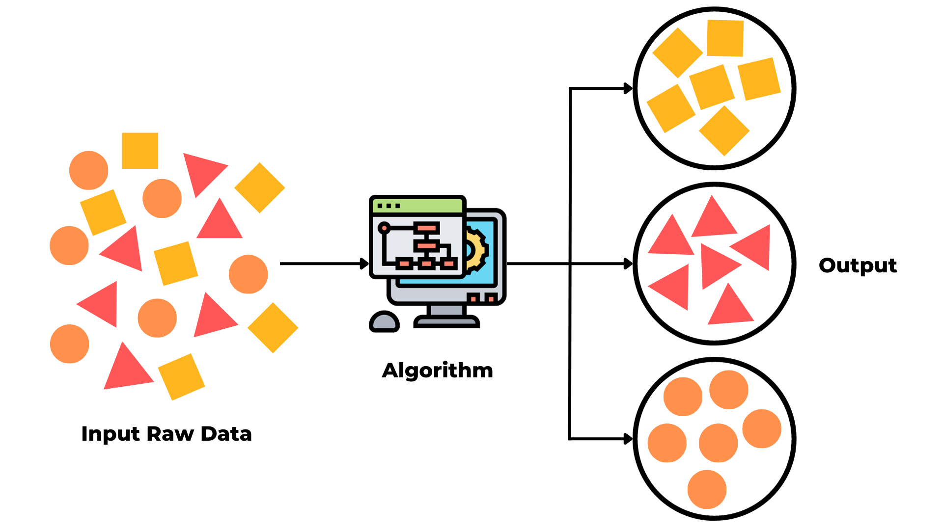
Machine Learning in Traffictelligance
Supervised learning algorithms use labeled data to forecast future traffic volumes.
Unsupervised learning identifies patterns and anomalies in traffic data without predefined labels.
These techniques adapt to changing network conditions, providing real-time, precise estimations.
Notes:
Image source: https://eastgate-software.com

Slide 8
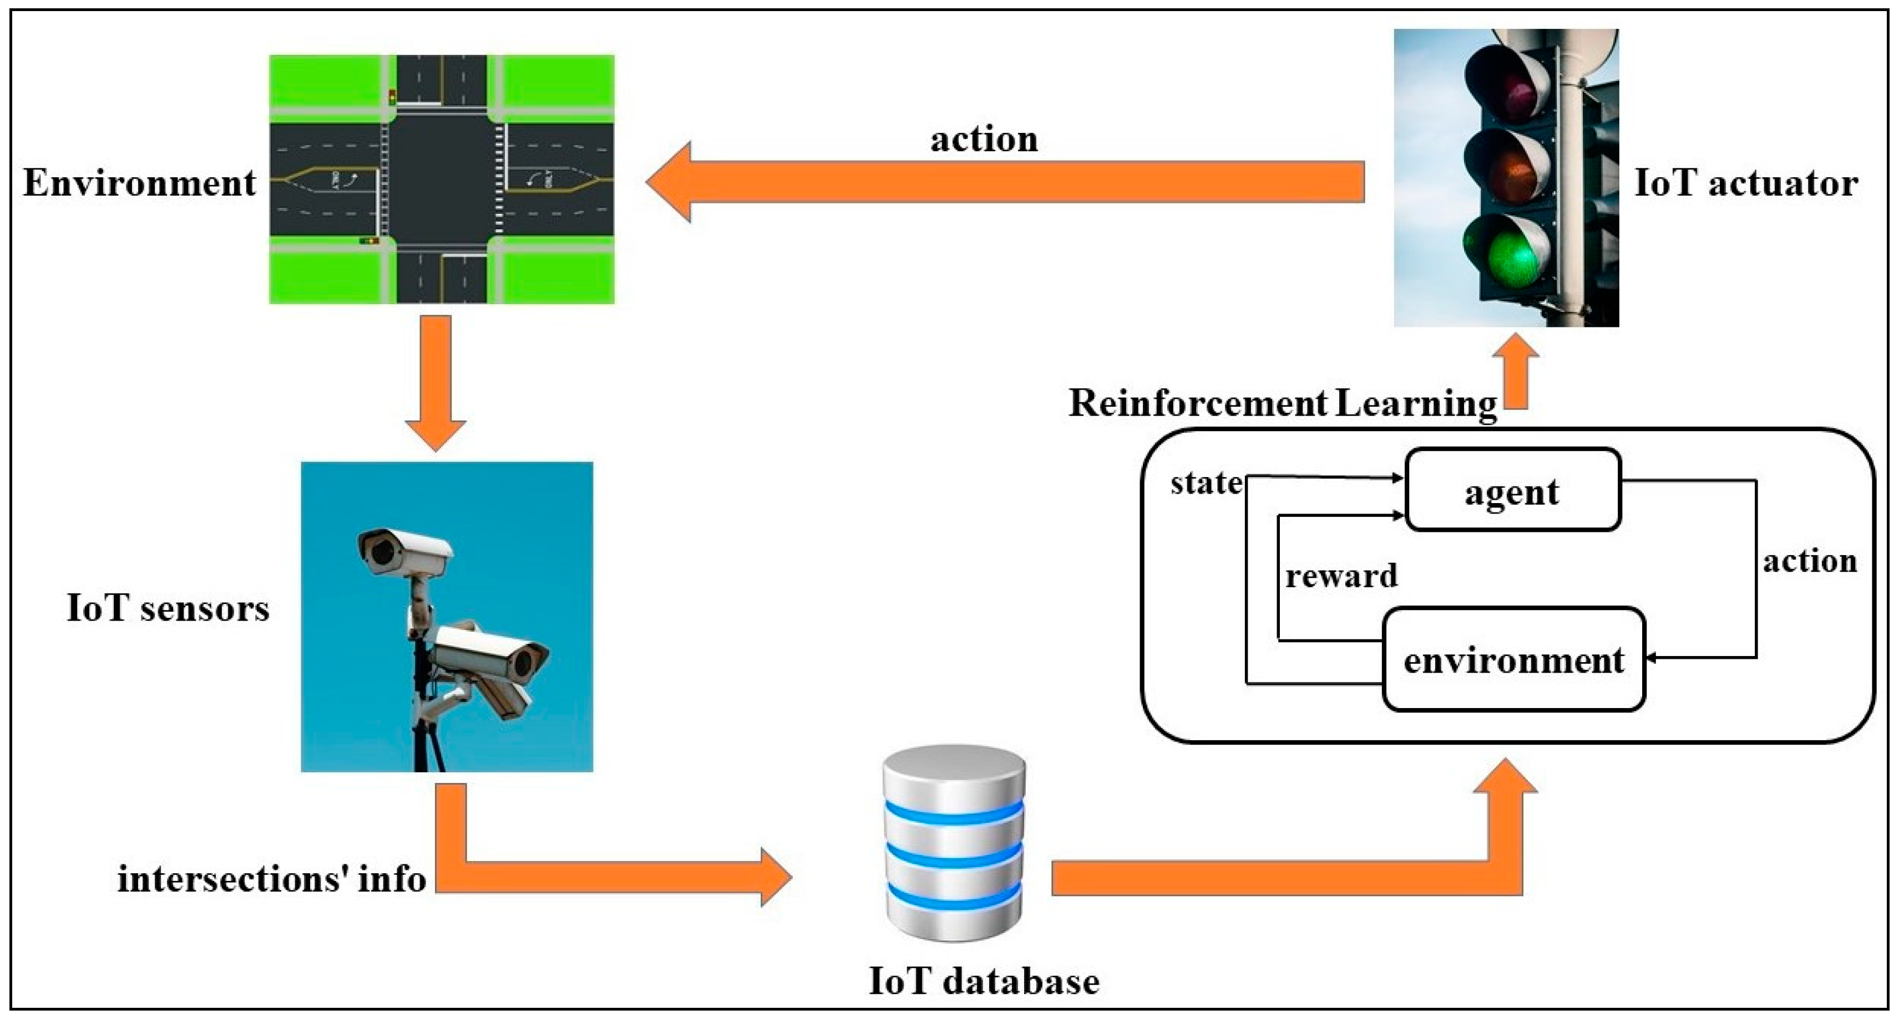
Data Collection and Processing for Estimation
Data sources include network probes, flow records, subscriber data, and external factors like events.
Data preprocessing involves cleaning, filtering, and aggregating to ensure accuracy.
Effective data management is crucial for reliable modeling and precise traffic volume estimation.
Notes:
Image source: https://pub.mdpi-res.com

Slide 9
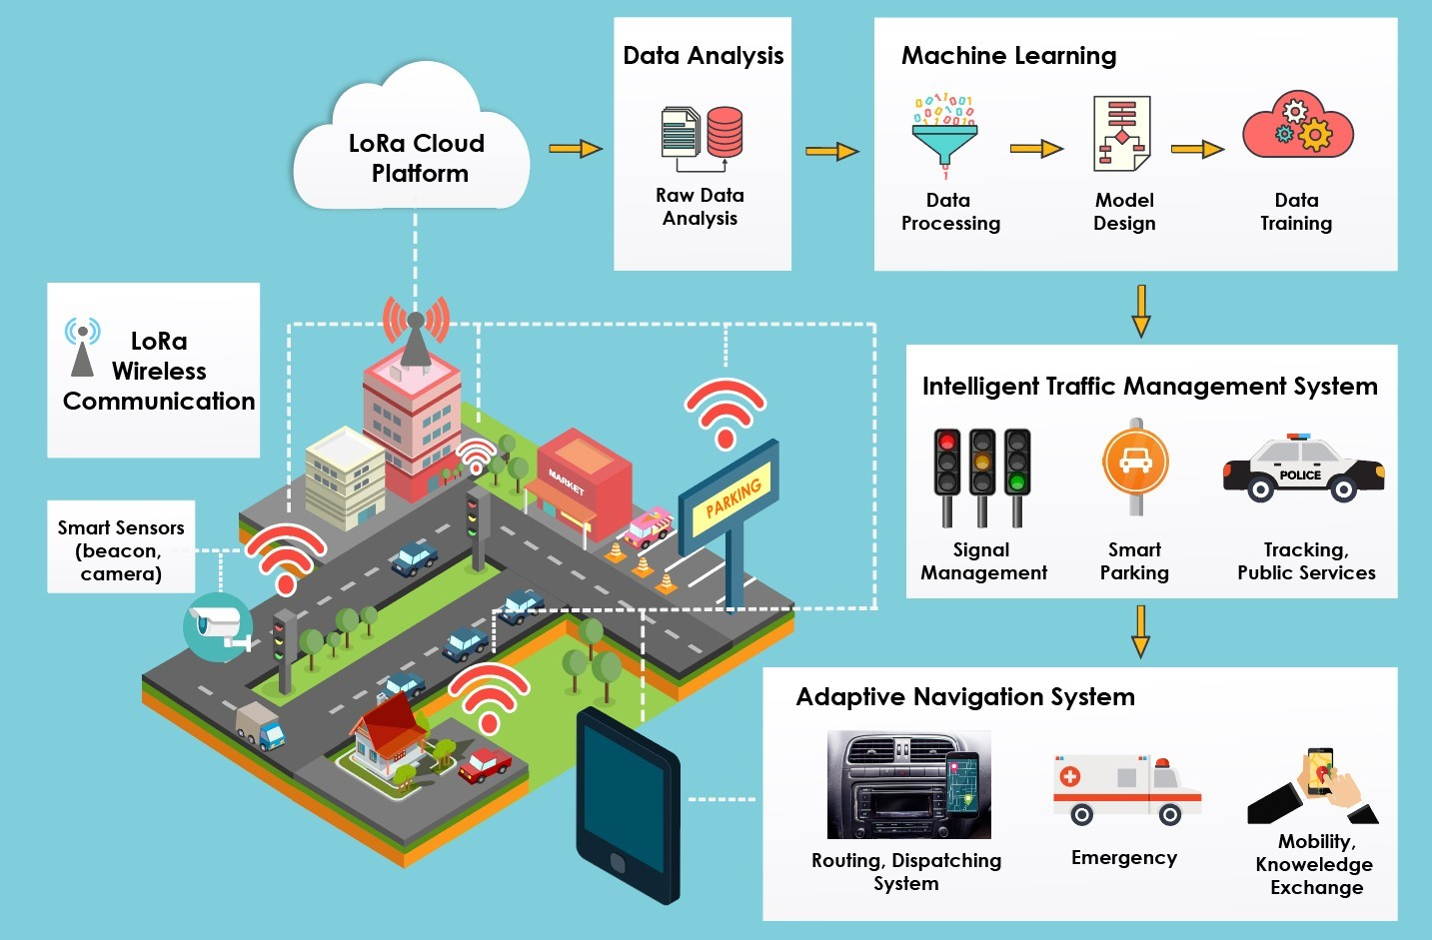
Benefits of Advanced Traffic Volume Estimation
Enables proactive network management and capacity planning to prevent congestion.
Supports dynamic resource allocation, improving overall network efficiency.
Facilitates better decision-making for infrastructure investments and policy adjustments.
Notes:
Image source: https://cmte.ieee.org

Slide 10
Future Trends in Traffic Volume Estimation
Integration of AI and big data analytics will further enhance prediction accuracy.
Deployment of 5G and IoT devices will generate richer datasets for more granular estimates.
Continuous innovation in modeling techniques will address emerging complexities in network traffic.
Notes:
Image source: https://i.ytimg.com

Slide 11
References
Traffictelligance Official Documentation and Whitepapers.
Research articles on machine learning applications in network traffic estimation.
Industry reports on advanced traffic management and capacity planning techniques.

